Slide 1
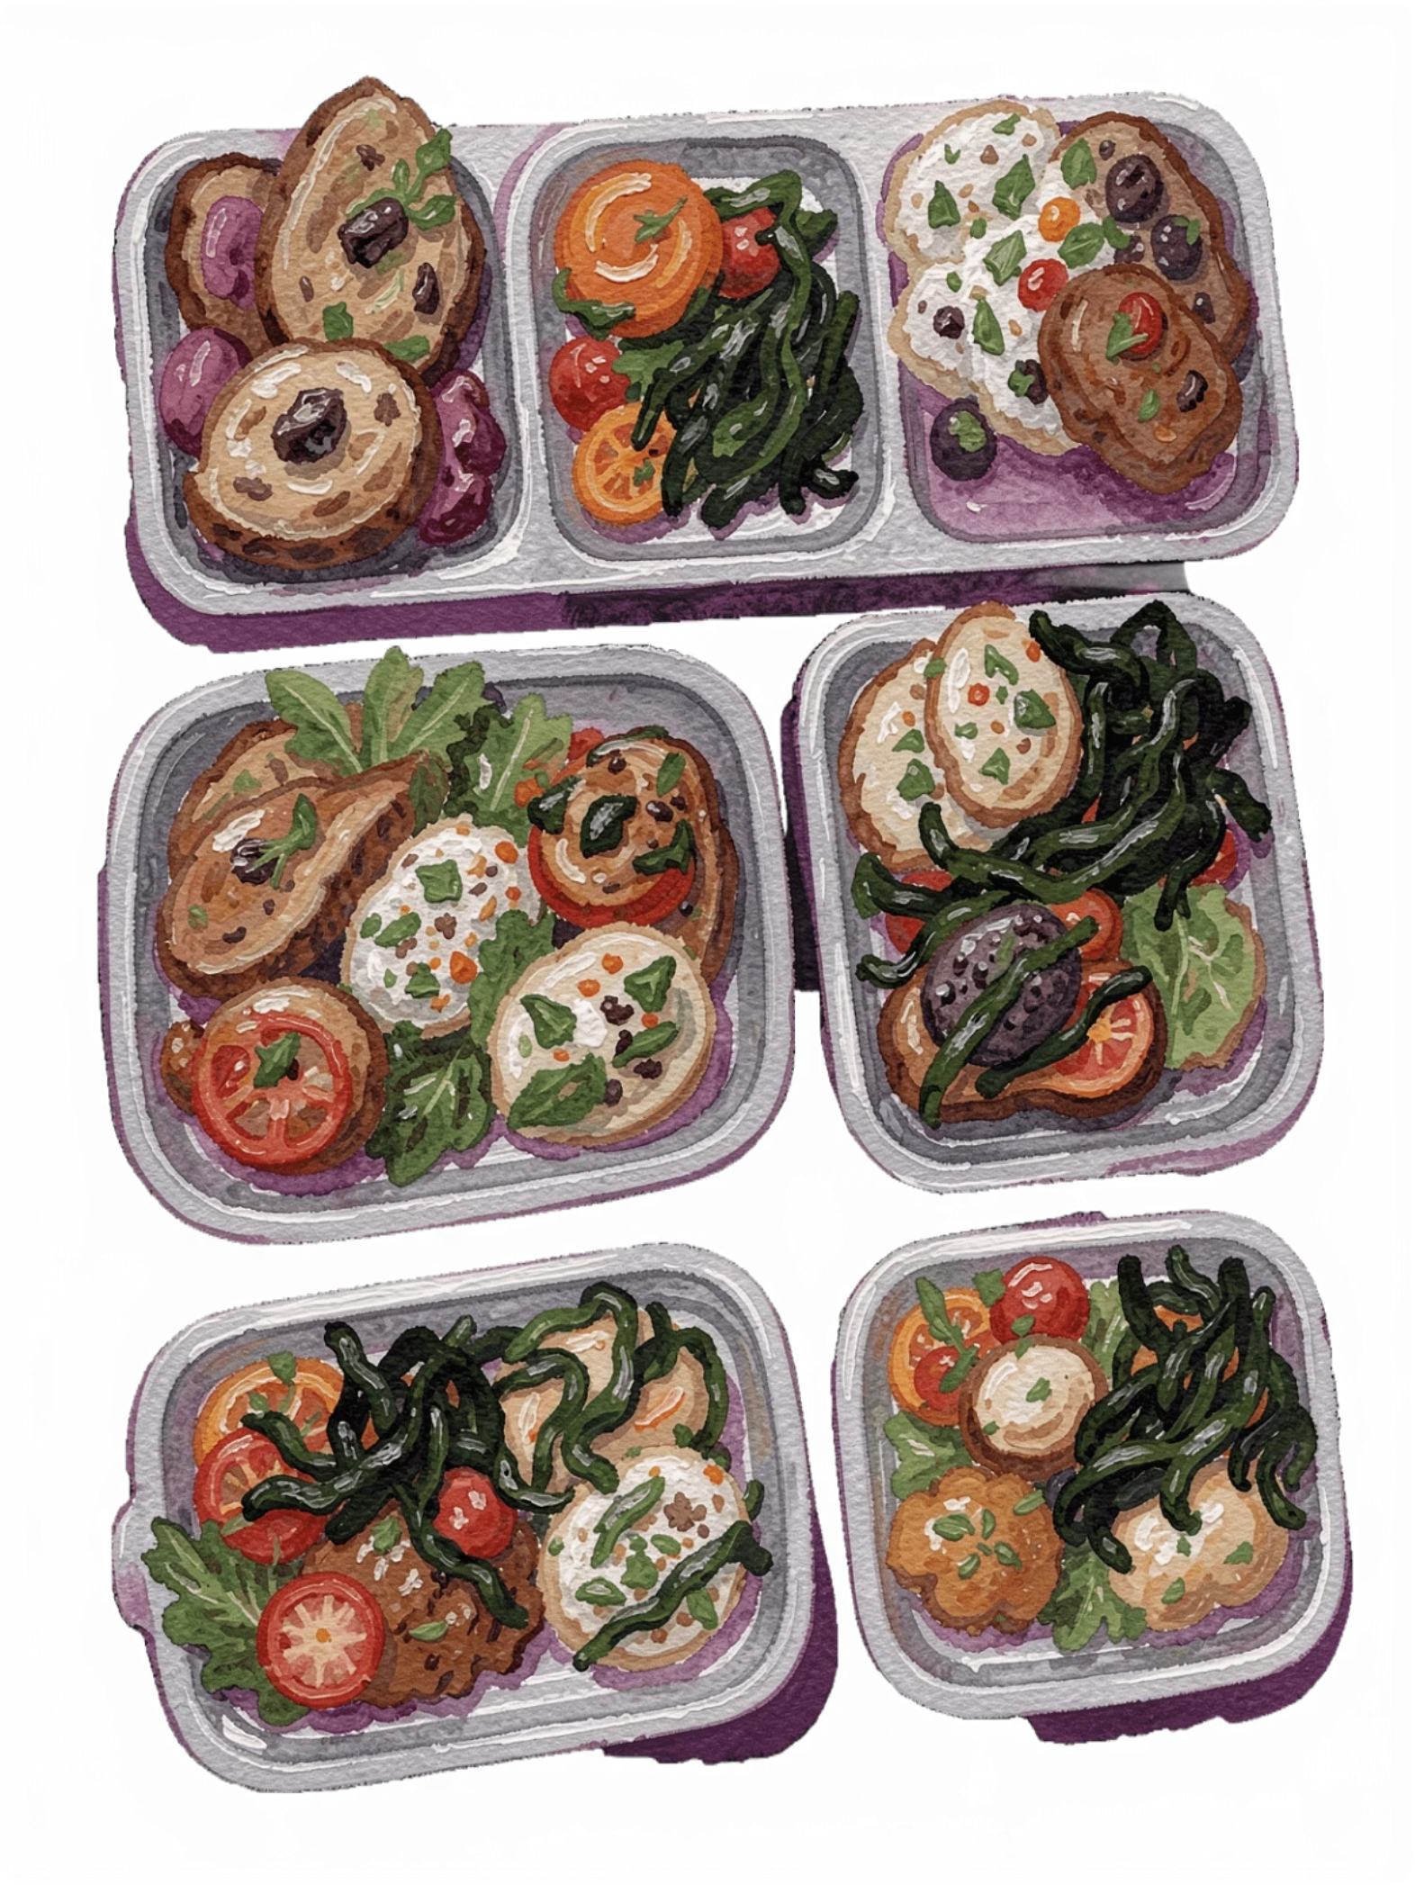
ReServe AI — Rescue More. Waste Less.
AI-Powered Campus Food Surplus Prevention & Intelligent Redistribution System
Student: Ilakkiyan J | Institution: Karpagam College of Engineering
Branch: Computer Science & Design | Mentor: Manasa
Program: 1M1B – IBM SkillsBuild AI + Sustainability Virtual Internship (July–Sep 2026)

Slide 2
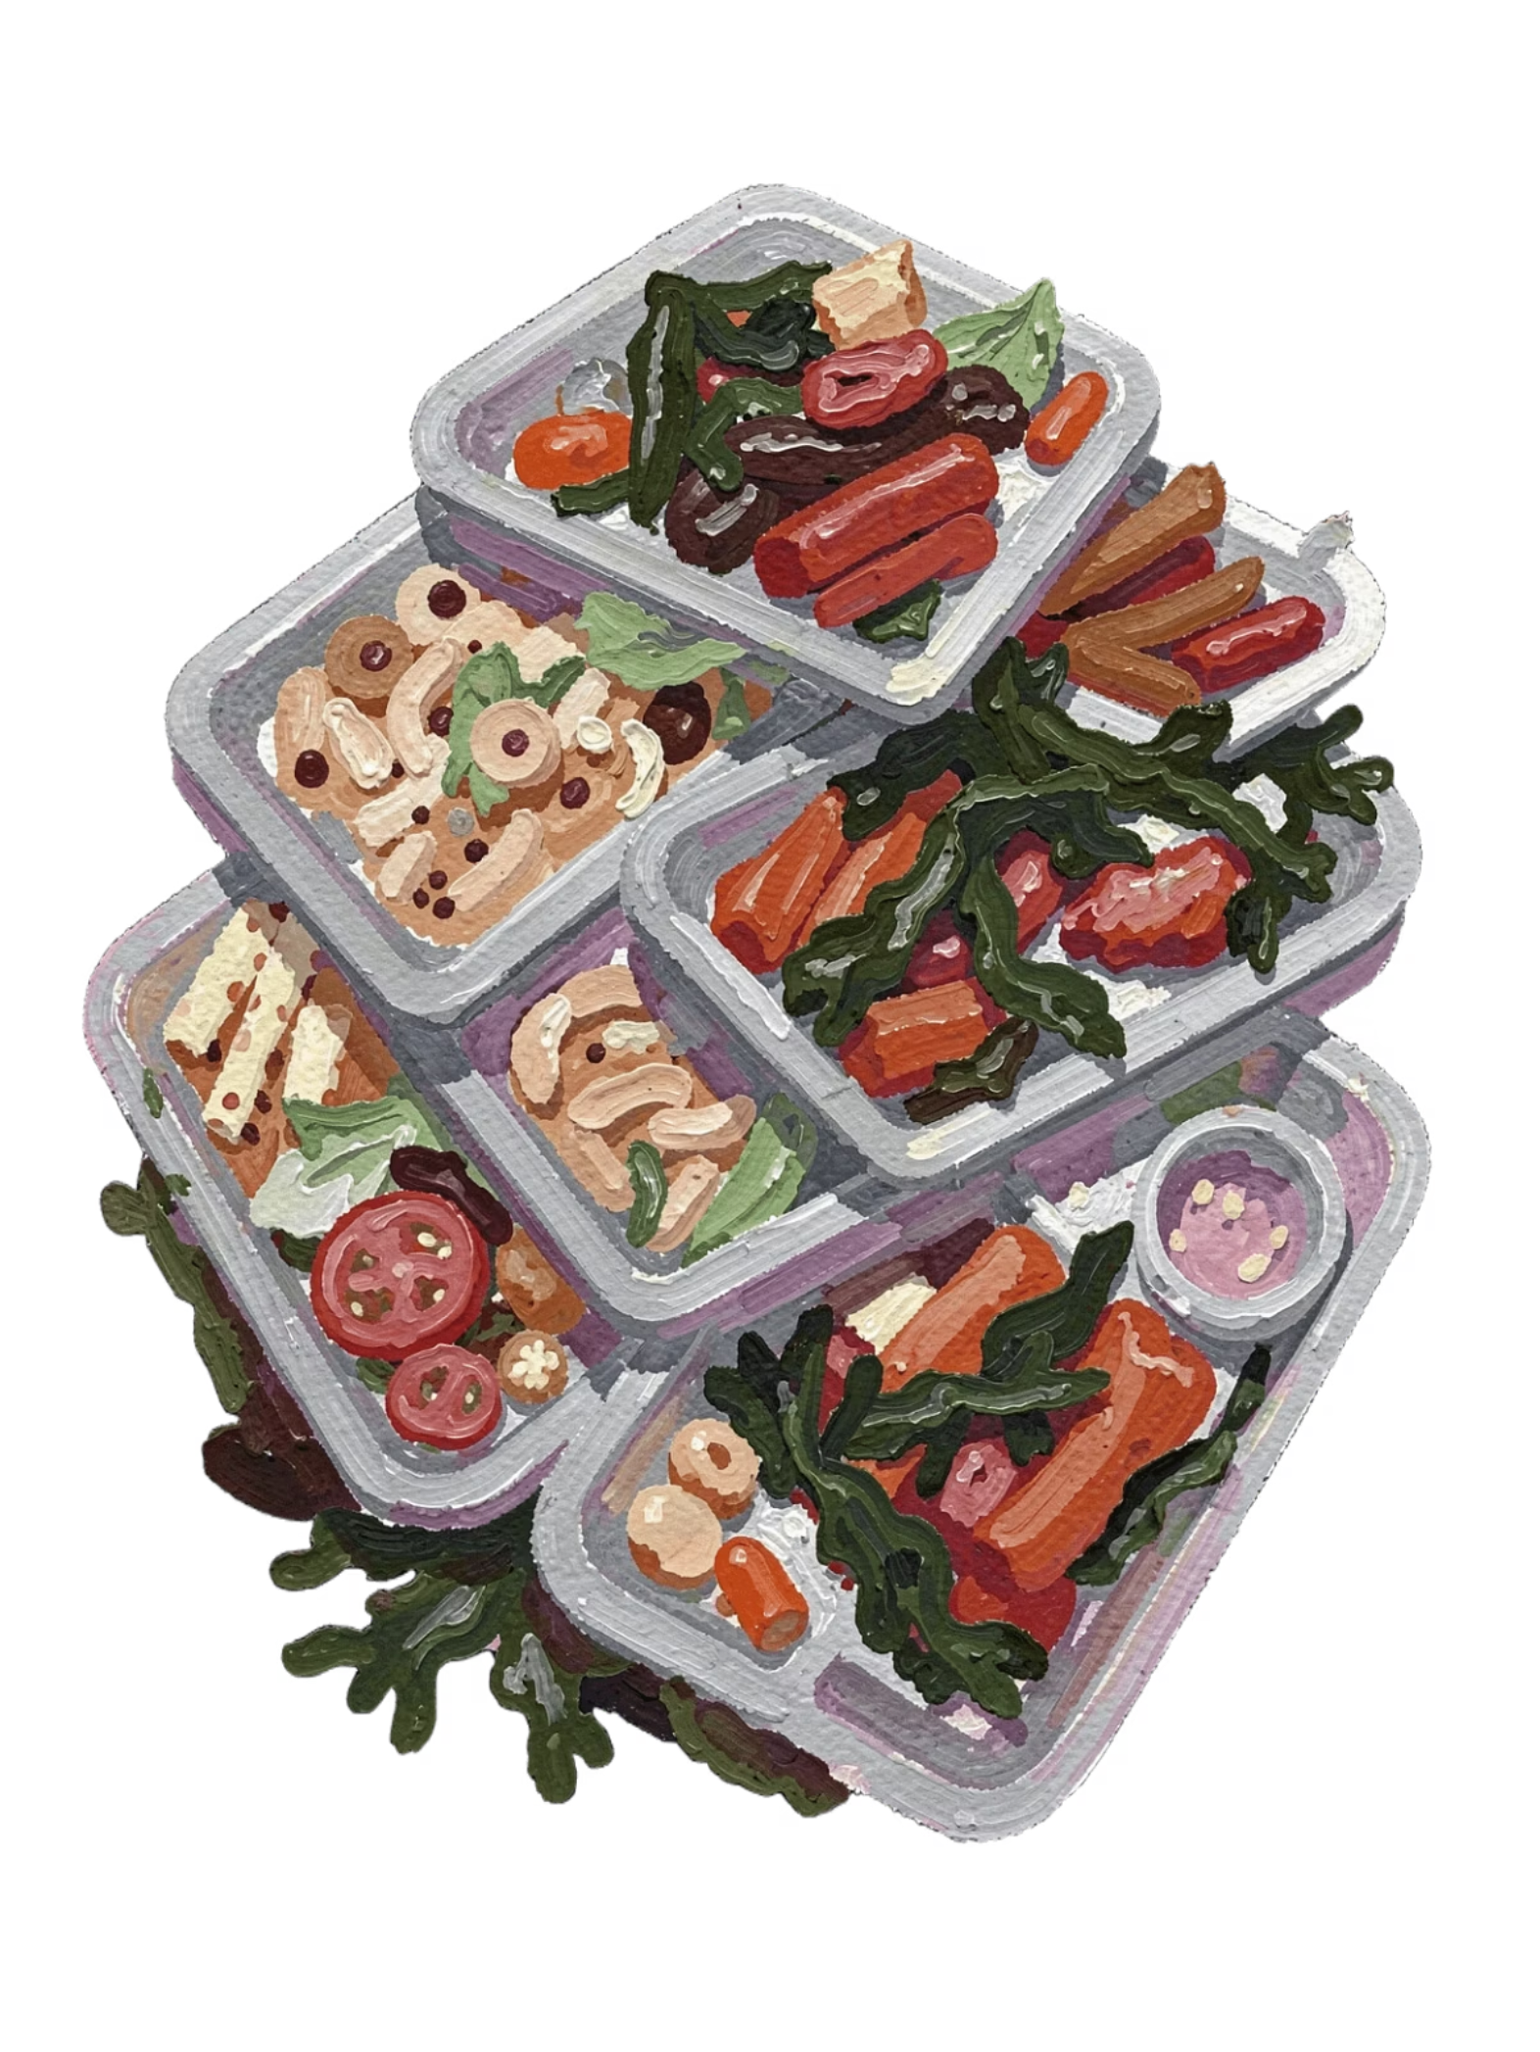
The Problem: Campus Food Waste at Scale
Cafeterias over-prepare by 15–25% daily, and much of it is never served.
Event leftovers are often discarded because there’s no redistribution channel.
Nearby shelters within 5–10 km face food insecurity while campuses waste meals.

Slide 3

OUR CENTRAL QUESTION
How Might We Use AI to Close the Gap?
How might we use AI to predict cafeteria demand and match surplus event food with verified local rescue organizations so campus redistribution becomes sustainable, transparent, and efficient?
This is the design challenge driving every component of ReServe AI — from forecasting algorithms to real-time logistics tracking.

Slide 4
UN Sustainable Development Goals
SDG 12 — Responsible Consumption
SDG 2 — Zero Hunger
SDG 11 — Sustainable Cities
Secondary Goal. Safe, nutritious food for all. Rescued meals are redirected to verified local shelters.
Secondary Goal. Less food waste lowers methane emissions and reduces the urban carbon footprint.
Primary Goal. Halve food waste by 2030. ReServe AI reduces over-preparation and surplus destruction.

Slide 5

The Solution: Dual-Mode AI
PREVENT Mode
RESCUE Mode
Predicts demand before service starts, helping campus kitchens prepare the right amount of food.
Reduces overproduction, waste, and unnecessary cost.
Identifies safe surplus in real time and routes it for recovery instead of disposal.
Supports redistribution to verified partners and communities in need.

Slide 6
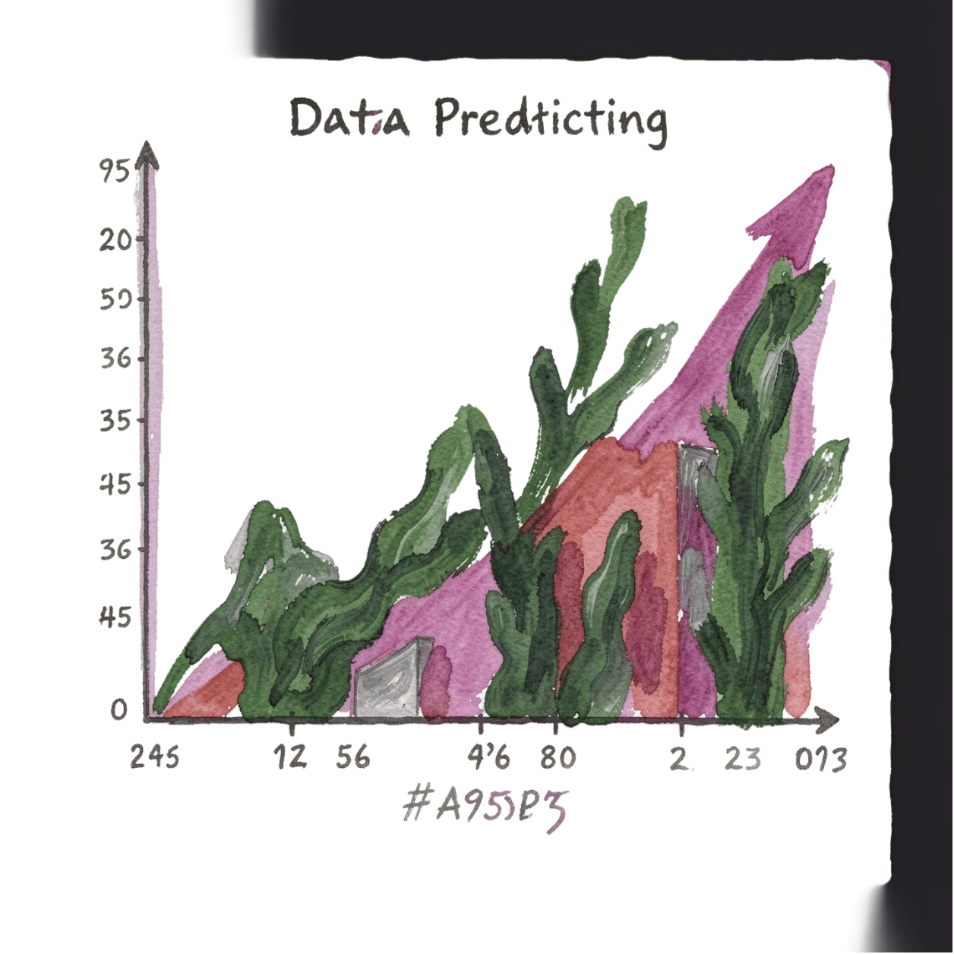

PREVENT Mode: Demand Forecasting
Predicts daily cafeteria demand by meal type and academic calendar.
Recommends a 5% safety buffer: Prep = ⌈Predicted × 1.05⌉.
Reduces over-production before food is ever prepared.
Tracks MAE/RMSE against actual consumption to improve accuracy.
The formula ⌈Predicted × 1.05⌉ ensures enough food without the 15–25% over-preparation margin currently wasted daily.

Slide 7



RESCUE Mode: Intelligent Matching
NLP Extraction
Multi-Criteria Matching
State Machine Tracking
Turns surplus event text into structured fields: quantity, food type, location, deadline.
Ranks verified NGOs by capacity, proximity, urgency, and reliability.
Tracks pickups in real time: ASSIGNED → IN_TRANSIT → ARRIVED → COMPLETED.

Slide 8
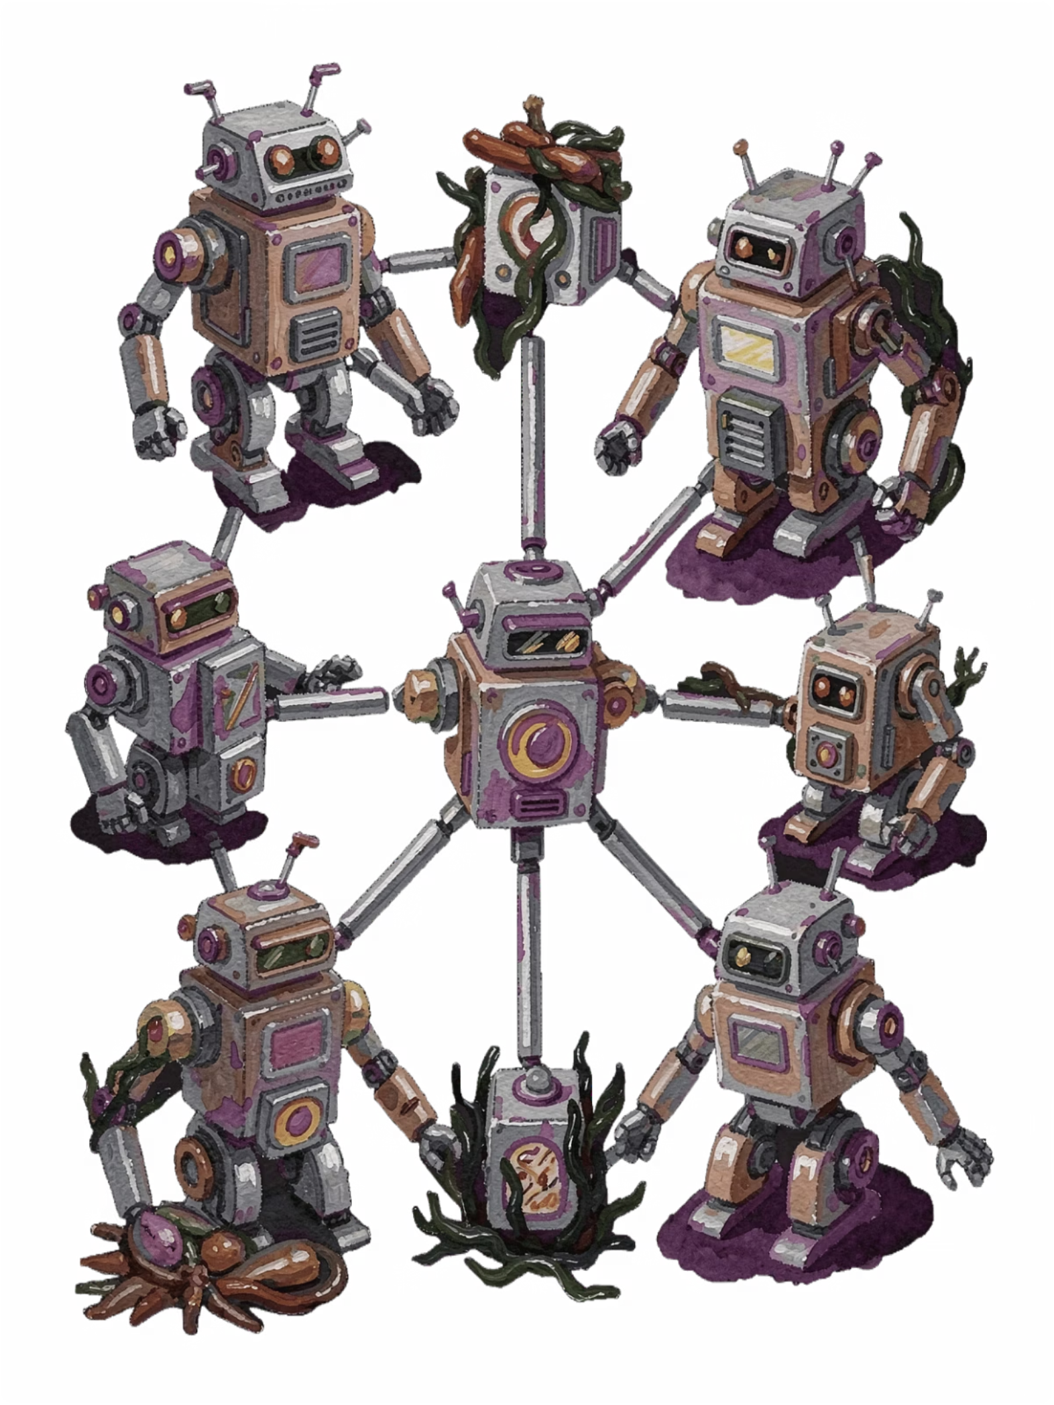
AI Architecture & Agents
1. Intake Agent
Ingests incoming requests and identifies the task type.
2. Parsing Agent
Extracts key fields and normalizes unstructured input.
3. Matching Agent
Finds the best fit using rules, signals, and priorities.
4. Verification Agent
Checks outputs for quality, safety, and consistency.
5. Coordination Agent
Routes work between agents and manages handoffs.
6. Reporting Agent
Summarizes results for users and system logs.

Slide 9
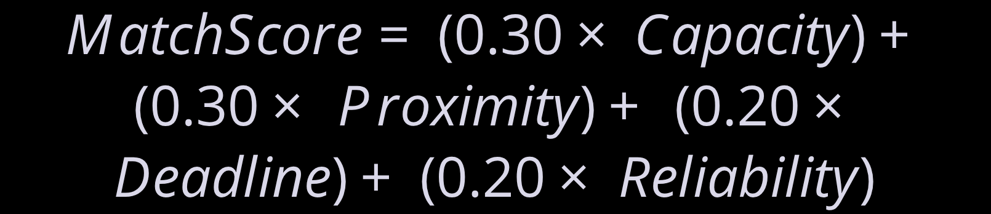
Demand Prediction & Matching Formulas
Demand Prediction
Multi-Criteria Matching
Breakfast 0.85
Lunch 1.10
Dinner 0.95
Capacity (30%)
Proximity (30%)
Deadline (20%)
Reliability (20%)

Slide 10
Technical Implementation — Tech Stack
Frontend
Backend
Database
AI/ML
Next.js 14, TypeScript, React
Node.js API routes, Prisma ORM
SQLite dev / PostgreSQL prod
LLM agents for NLP, RAG, scoring
Knowledge Base
FDA Food Code 2023 + campus manual

Slide 11
System Data Flow
Input Layer → AI Processing → Persistence → Output Layer

Slide 12

Responsible AI Evaluation
IBM Responsible AI Framework Audit
Fairness
Transparency
Objective criteria prevent organizational bias.
Score breakdowns explain each matching decision.
Ethics
Privacy
Verified boundaries and human review ensure accountability.
RBAC and HttpOnly JWTs protect sensitive data.

Slide 13

Expected Impact
15,000+
6.2+
Meals rescued for local shelters
Metric tons of CO₂ avoided
$15,000+
18%
Saved in disposal and hauling fees
Reduction in over-preparation waste

Slide 14
Stakeholder Benefits
University
Recipient NGOs
Community
SDG compliance and reduced waste costs.
Stronger green reputation.
Reduced landfill burden.
Healthier urban ecosystem.
Real-time fresh food alerts.
Zero procurement cost.
Cafeteria
Optimized prep schedules and
10–15% procurement savings.
Event Organizers
30-second leftover reporting.
No guilt over discarded catering.

Slide 15
Conclusion & Future Outlook — Circular Campus Food Systems
ReServe AI transforms campus dining from a linear waste stream into a circular, sustainable ecosystem.
Proactive Waste Prevention
Real-time Community Food Rescue
Scalable Framework
Adaptable for universities, cities, and regional food banks to support broader sustainability.
Statistical forecasting minimizes over-preparation before it begins, optimizing resource use.
Intelligent matching redistributes surplus food to those in need through Responsible AI principles.
Building circular food systems where no meal is wasted and every community is fed.

Slide 16
Thank You
ReServe AI — Building Circular Food Systems
Questions & Discussion
Contact: Ilakkiyan J | ilakkiyanj03@gmail.com

